Slide 1
Multiple sources of variability
-
0
+

Slide 2

Multiple sources of variability
-
0
+
Individual
Growth
Survival
Recruitment

Slide 3
Multiple sources of variability
-
0
+
Individual
Temporal
time
Growth
Survival
Recruitment
Temperature
Precipitation

Slide 4
Multiple sources of variability
-
0
+
Individual
Temporal
Spatial
time
space
Growth
Survival
Recruitment
Temperature
Precipitation
Plot offsets
(growth / surv / recruit)

Slide 5
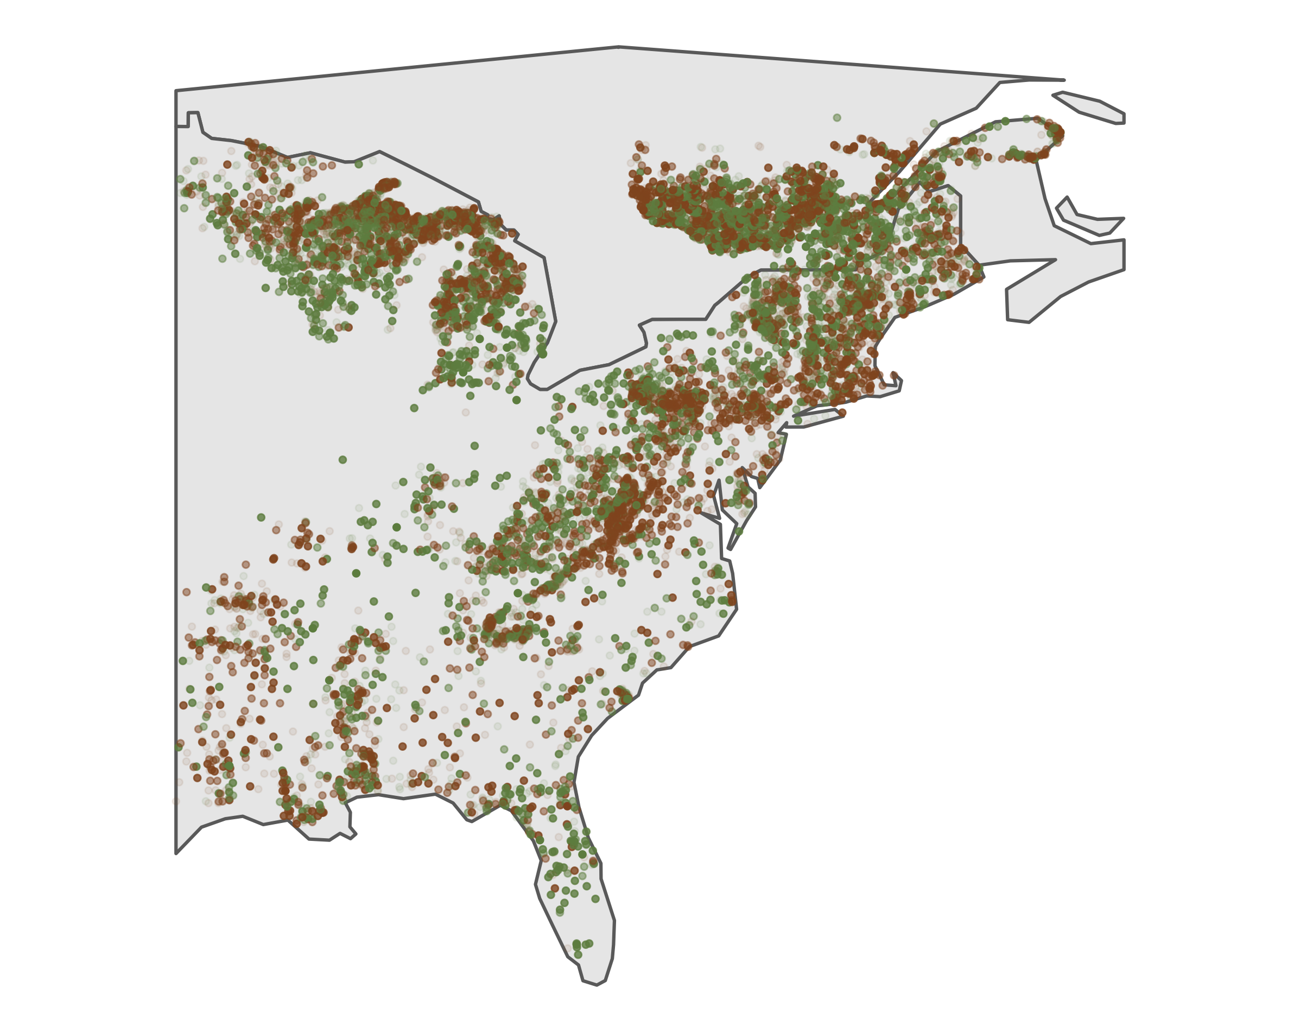
Suitable probability
t_{n}
…
t₂
t₁
λ

Slide 6
Suitable probability
t_{n}
…
t₂
t₁
1
ln(λ)

Slide 7
Suitable probability (Λ)
t_{n}
…
t₂
t₁
0
ln(λ)

Slide 8



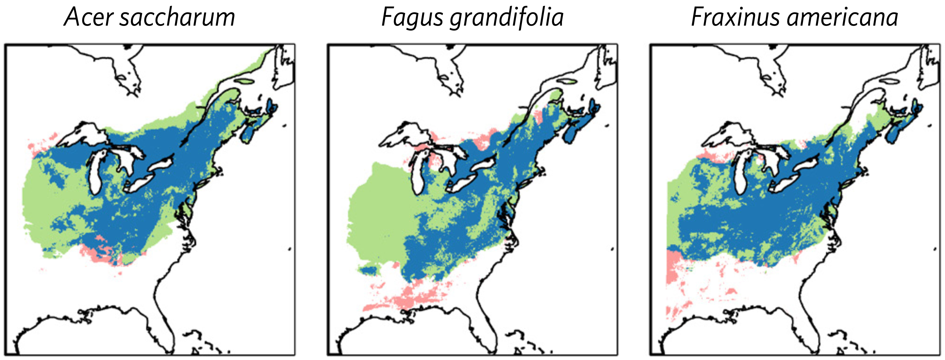
Continued presence
Colonization credit
Extinction debt

Slide 9
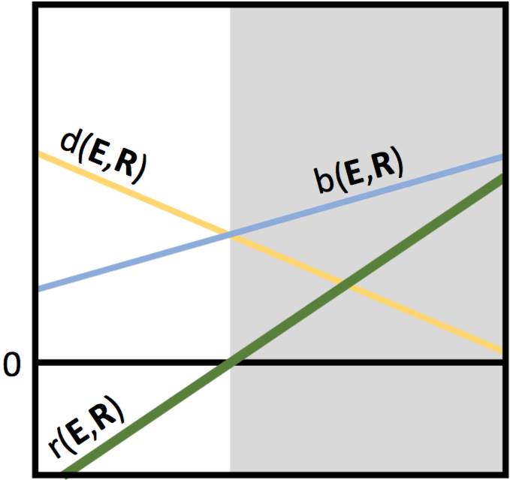
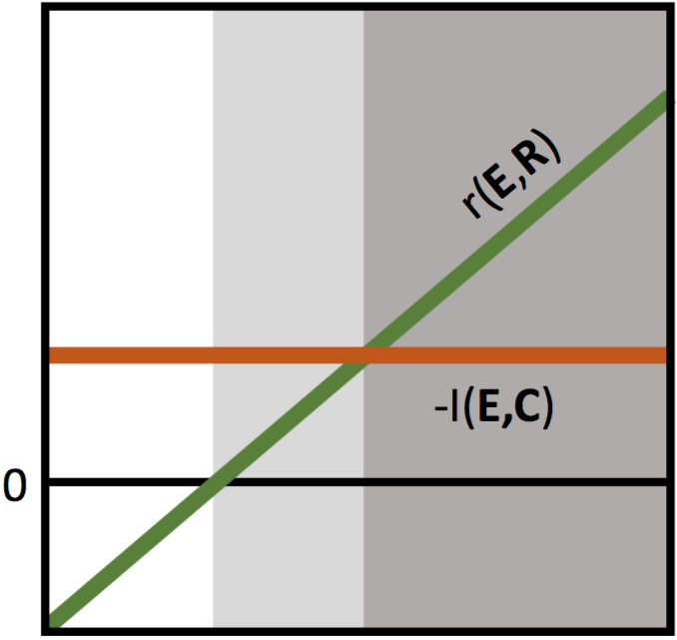
death(E)
birth(E)
Unsuitable
Components of
population growth
Fundamental Niche
0
r(E)
Environment (E)
r(E)
Components of
population growth
Unsuitable
-interaction(E)
Fundamental Niche
0
Realized Niche
Environment (E)

Slide 10
Size
Climate
Competition
Time (t)
Time (t + Δt)
Size (t)

Slide 11
Size
Climate
Competition
Growth
Survival
Recruit
Time (t)
Time (t + Δt)
Size (t)

Slide 12
Size
Climate
Competition
Growth
Survival
Recruit
Time (t)
Time (t + Δt)
Size (t)

Slide 13
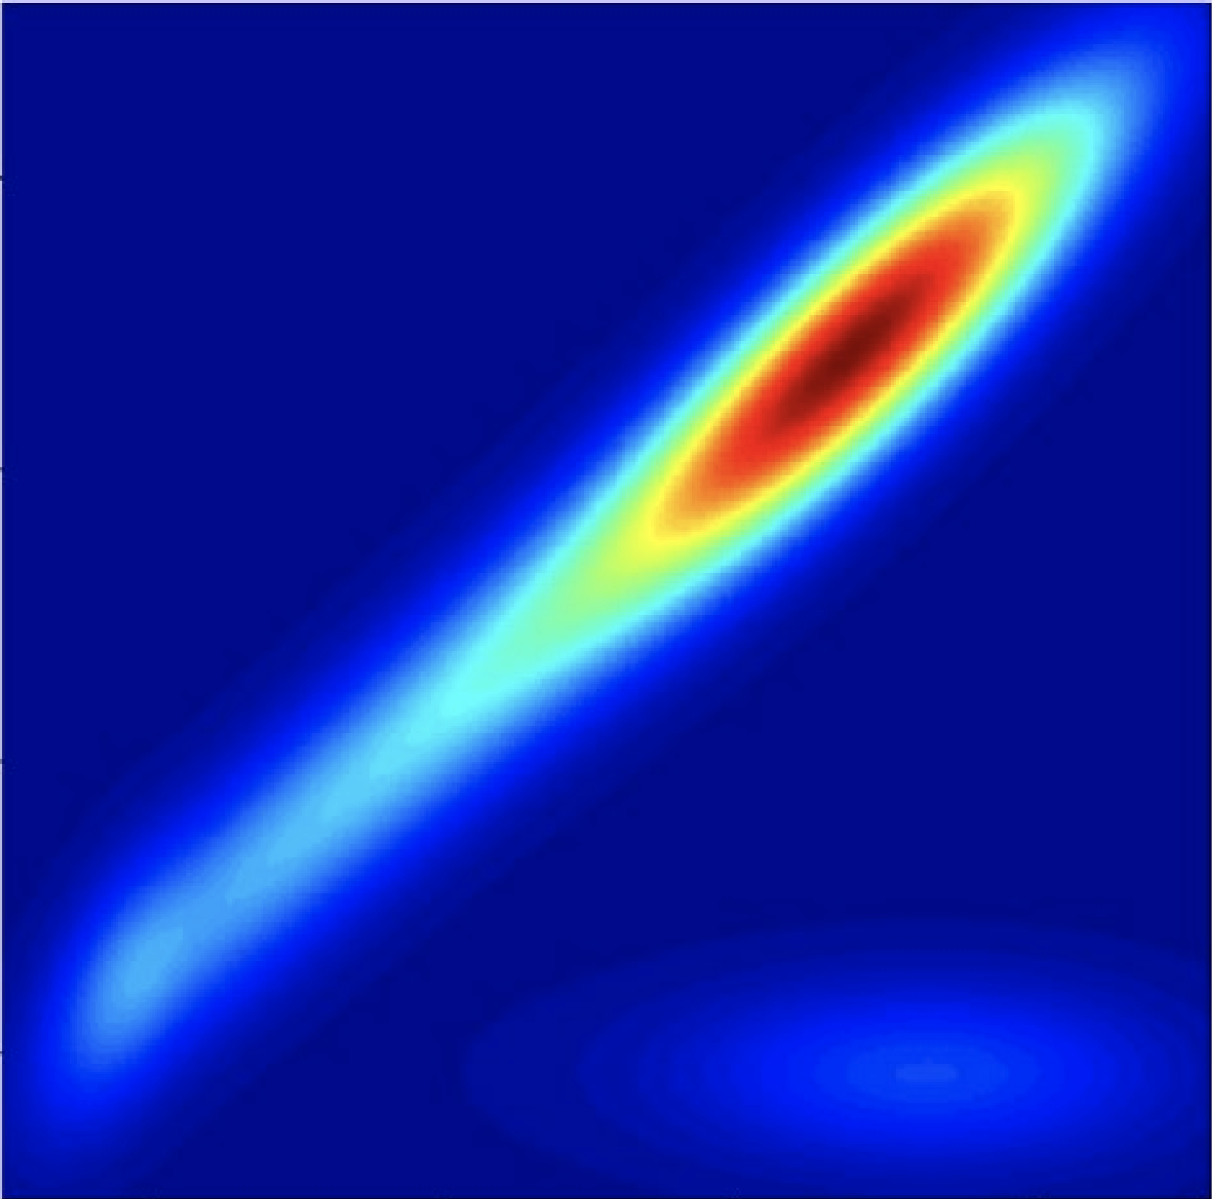
Size
Climate
Competition
Growth
Survival
Recruit
Time (t)
Time (t + Δt)
Integral Projection Model
Size (t + Δt)
Size (t)

Slide 14
Size
Climate
Competition
Growth
Survival
Recruit
Time (t)
Time (t + Δt)
Integral Projection Model
λ(climate, competition)
Size (t + Δt)
Size (t)

Slide 15
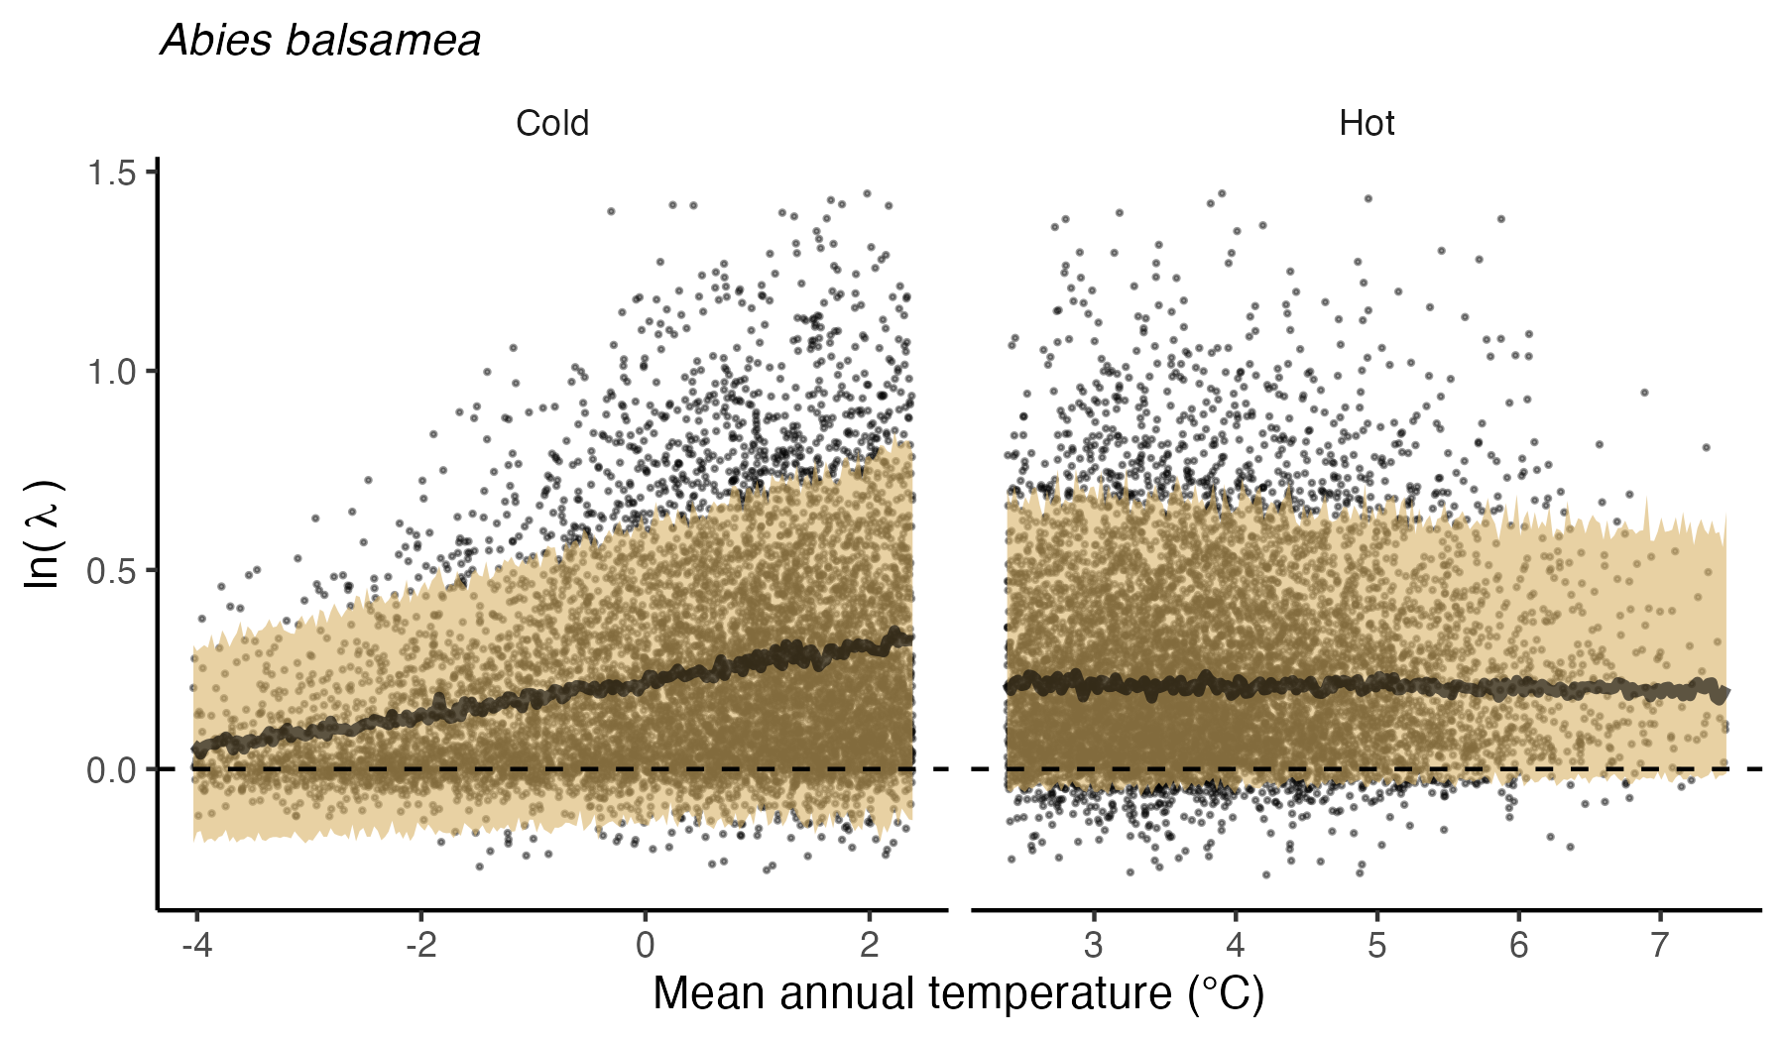

Slide 19
R
Plantation
Colonization
Harvest
Disturbance
Thinning
B
Exclusion
T
M
Enrich. planting
Invasion
Boreal
Temperate
Mixedwood

Slide 20
R
Colonization
Disturbance
B
Exclusion
T
M
Invasion
Boreal
Temperate
Mixedwood

Slide 21
R
B
T
M
Boreal
Temperate
Mixedwood

Slide 22
R
B
T
M
Boreal
Temperate
Mixedwood

Slide 23
R
Regeneration
Mature
B
T
M
Boreal
Temperate
M

Slide 24
R
B
T
M
Boreal
Temperate
Mixedwood

Slide 25
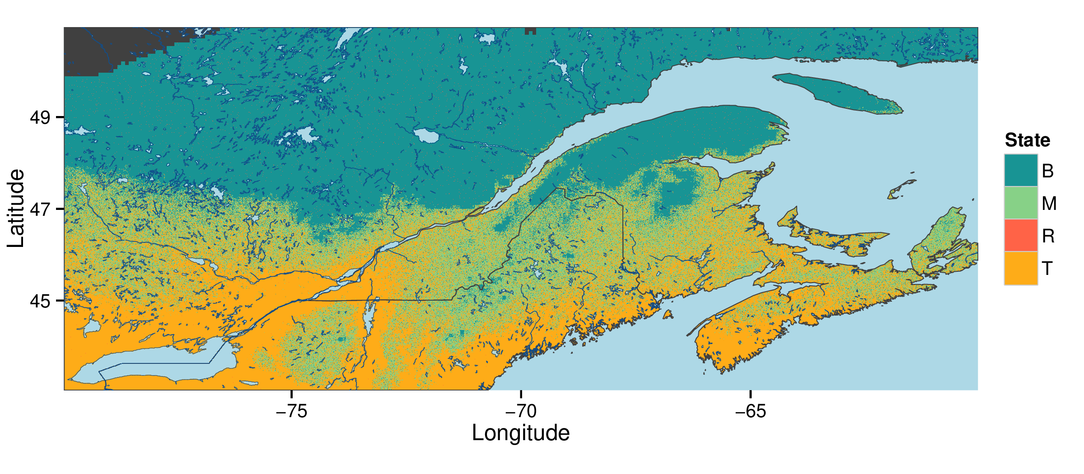
Boreal
Mixedwood
Temperate
Regeneration

